Slide 1
MY PHONE
Sanita Tifentale
Amil Osmanli
Kenneth Scally

Slide 2
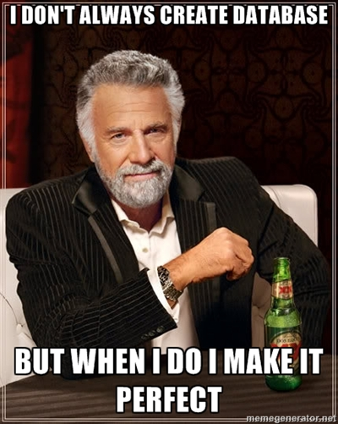
DESIGNING THE DATABASE
Mobile Phone Service Provider
Service on an account basis
Online and in store sales
The range of brands and models
Transaction contract:
Customer Detail
Phone Details
Plan Details
Phone Number
Billing every 2 months

Slide 3
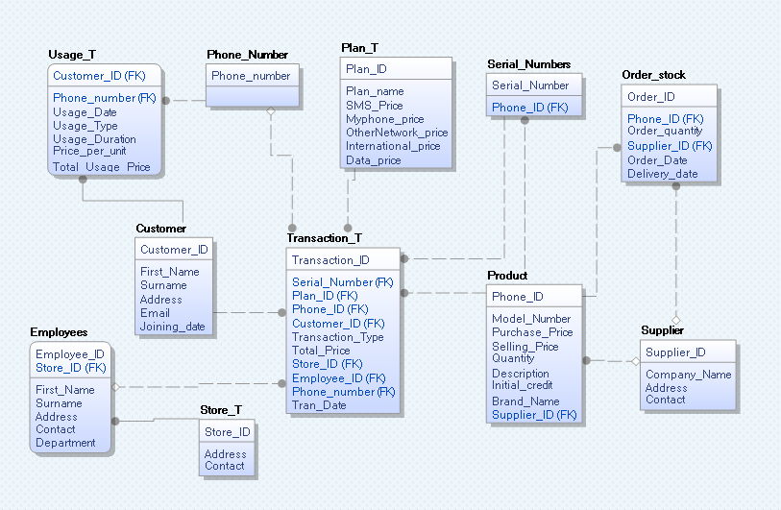
Erwin Model

Slide 4
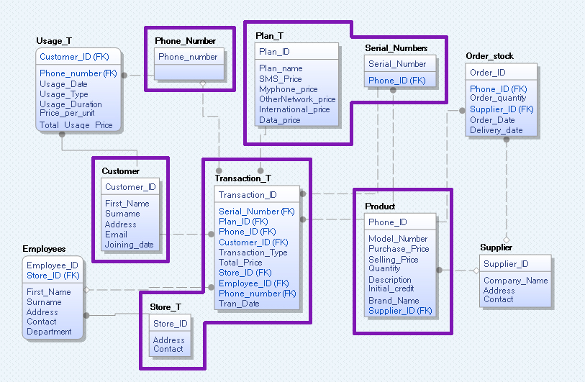
Sanita (sales) Erwin Model

Slide 5
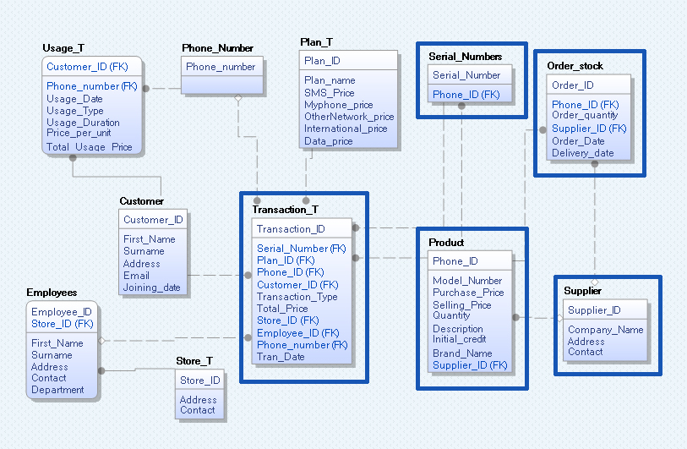
Kenneth (Stock admin) Erwin Model

Slide 6
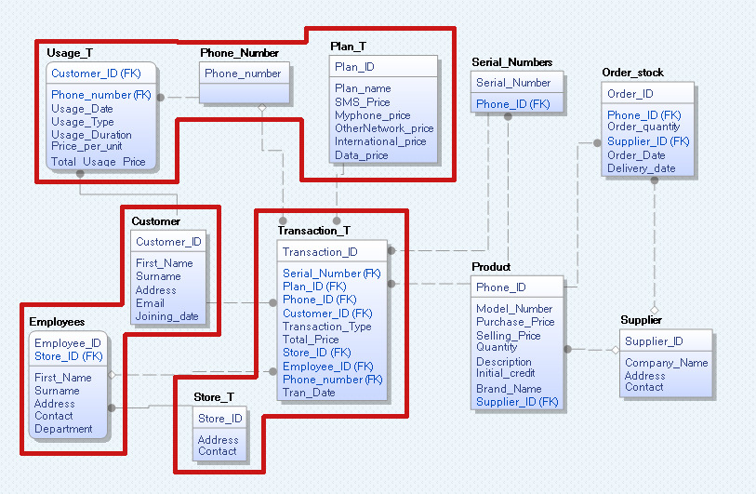
Amil (billing and admin for
employee) Erwin Model

